Slide 1


Slide 2
A Chatbot Teaching Assistant For Improving Student Success
Jason Keith, Iowa State University
Amin Amirlatifi, Mississippi State University
Sudip Mittal, The University of Alabama
Subash Neupane, Meharry Medical College
Himanshu Tripathi, The University of Alabama
Shahram Rahimi, The University of Alabama

Slide 3
Presentation Contents
Introduction / Objective
Prior Work
Architecture
Example I: Numerical (Reservoir Rock Properties & Fluid Flow)
Example II: Coding (Introduction to Computer Science & Engineering)
Acknowledgments / Future Work

Slide 4
Introduction / Background / Objective
Lack of fiscal resources to support academic student success
Many students leave their major or the university “gateway” courses with high DFW rates
AI technology offers a promising solution!
BarkPlug is a virtual TA for some of MSU’s most difficult courses in the Bagley College of Engineering

Slide 5
Prior Work
BarkPlug 1.0
Specifically tailored to the unique needs of BCoE’s college & university community
Prospective students exploring academic programs and admissions requirements
Current students seeking campus resources and event information
BarkPlug serves as a virtual assistant, capable of delivering personalized guidance and support

Slide 6
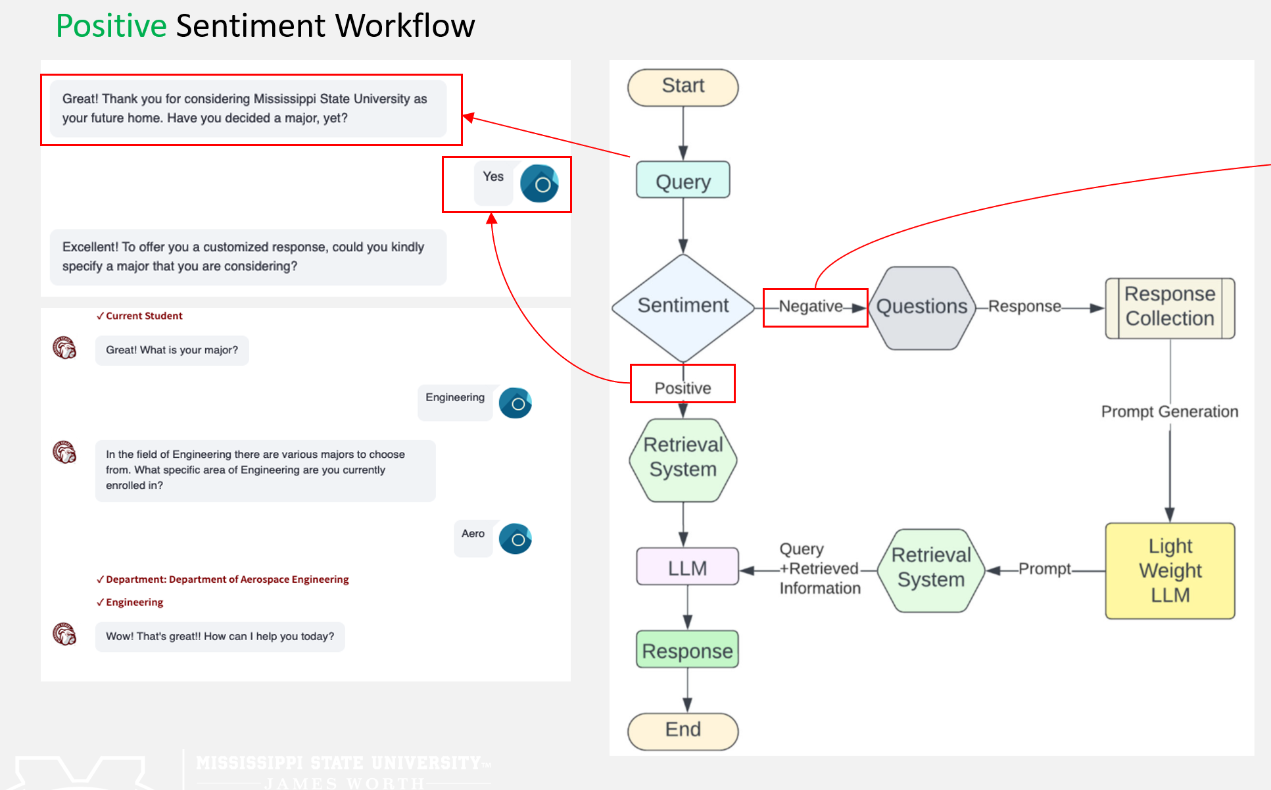
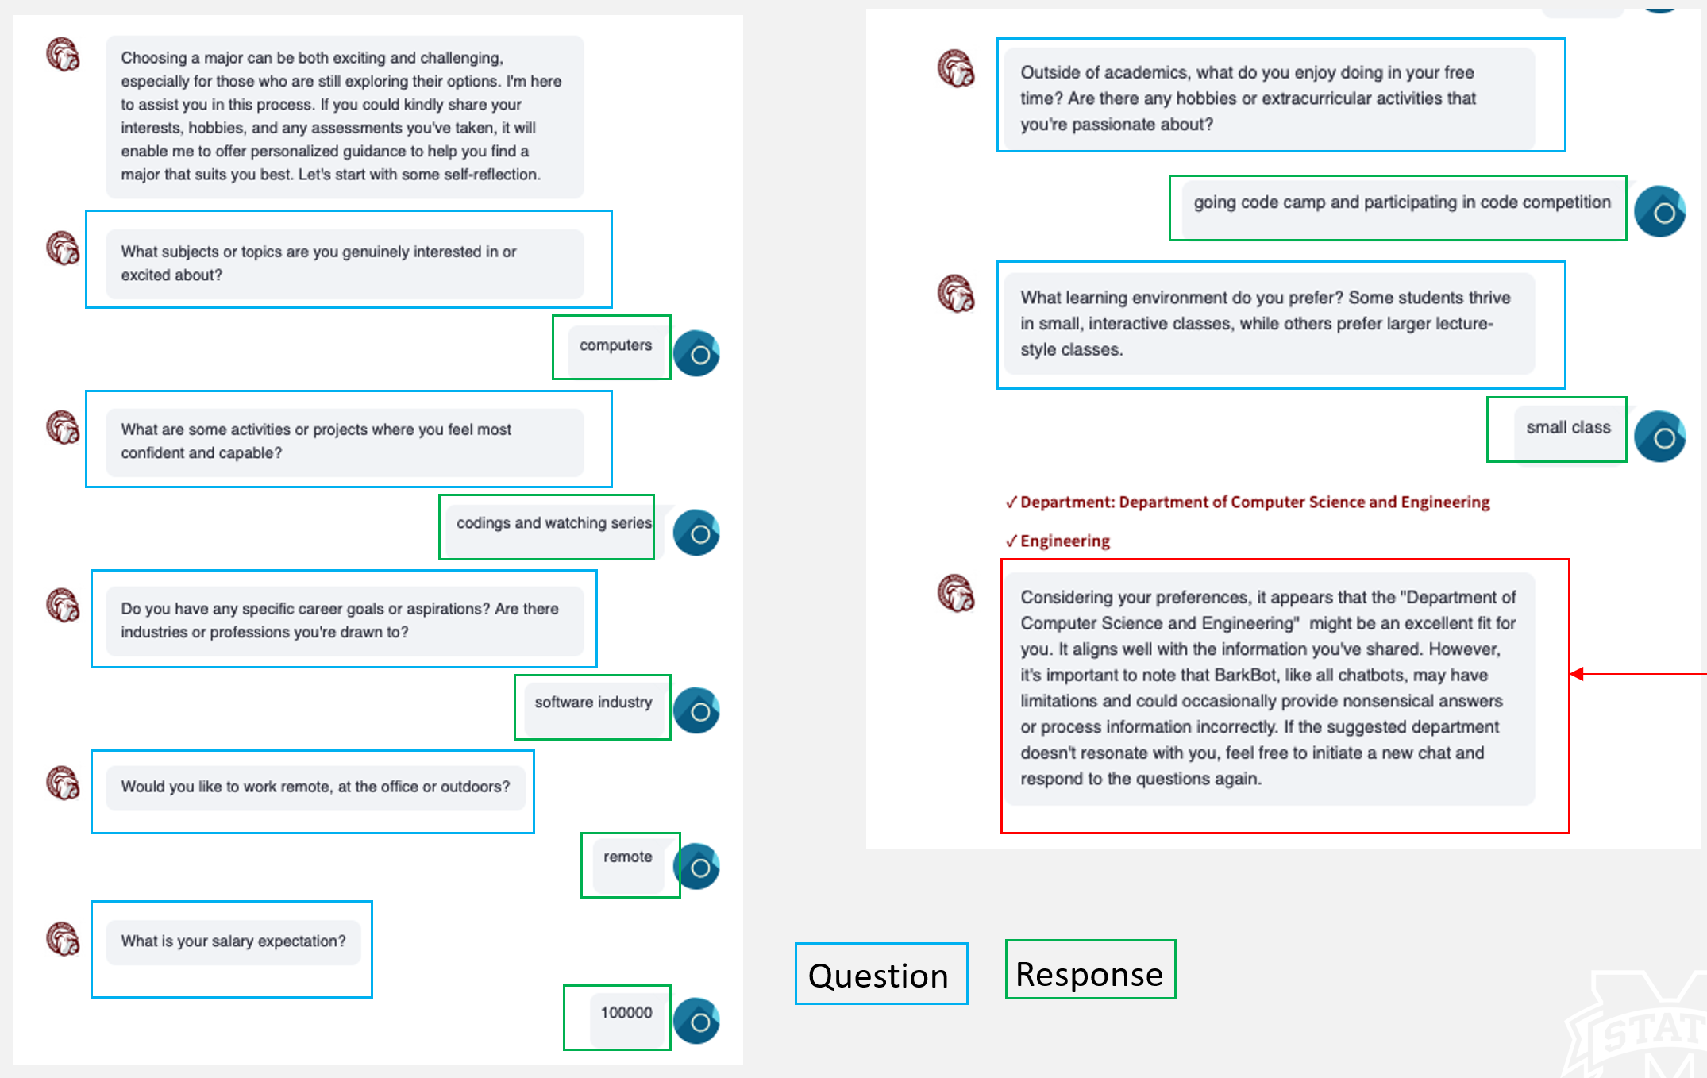
Prior Work
BarkPlug 1.0’s unique features (at that time)
Sentiment Analysis and Large Prompt Creation
Retrieval Augmented Generation (RAG)

Slide 7
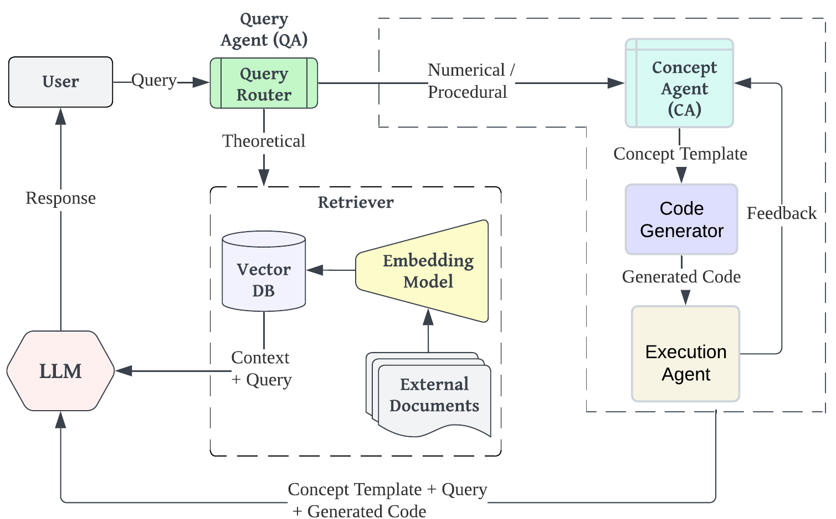
TA Chatbot Architecture
BarkPlug 2.0
Ability to assist with disciplinary specific courses
PTE Reservoir Rock Properties
CSE Introduction to Computer Science and Engineering
TA Chatbot Architecture (BarkPlug 2.0)

Slide 8
Query Router
prompt = f"""
Instruction: You are an AI assistant trained to classify user queries into two categories: Theoretical or Numerical-Procedural. Follow these guidelines:
1. Theoretical: The query involves abstract concepts, principles, or qualitative reasoning. It seeks explanations, definitions, or discussions without requiring calculations, numerical results, or step-by-step procedures.
2. Numerical-Procedural: The query involves numbers, calculations, data analysis, code, or step-by-step instructions. It seeks specific numerical answers, solutions to equations, code implementations, or procedural guidance.
Task: Read the user query below and classify it as either Theoretical or Numerical-Procedural. Provide only the classification as your output.
User Query: {query}
Output: """
Zero-shot prompt for query classification.
Notes:
The first module is the Query Router, which acts as the entry point for the system. The objective of this module is to classify the user's query into one of two categories: theoretical or numerical/code based. It employs a lightweight classifier, such as a smaller fine-tuned LLM, to predict the query type based on its structure and keywords.

Slide 9
Theoretical Path: RAG Workflow
Query | Query Classification | Response
What is the concept Behind Initial Fluid Saturation in a Reservoir | Theoretical | The concept behind Initial Fluid Saturations in a reservoir involves the idea that pores are initially saturated with water (S_{w}=1), and hydrocarbons migrate into traps due to having a density less than water density. The distribution of hydrocarbons in the reservoir is such that gravity and capillary forces are in equilibrium. The minimum interstitial water saturation remains in the hydrocarbon zone even after accumulation occurs. Wettability plays a role, with water-wet conditions in drainage accumulation processes and oil-wet conditions in imbibition accumulation processes. Residual non-wetting phase saturation is also a factor in this concept.
Response generation to theoretical question using RAG workflow.
Notes:
the RAG system begins by retrieving the top-k most relevant documents from a knowledge base, such as a Reservoir Rock Properties course or related textbooks. These documents, along with the user query, are then passed to an LLM for response generation. The LLM integrates the retrieved information to produce a comprehensive and scientifically accurate answer.

Slide 10
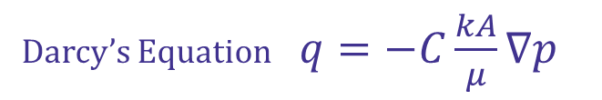
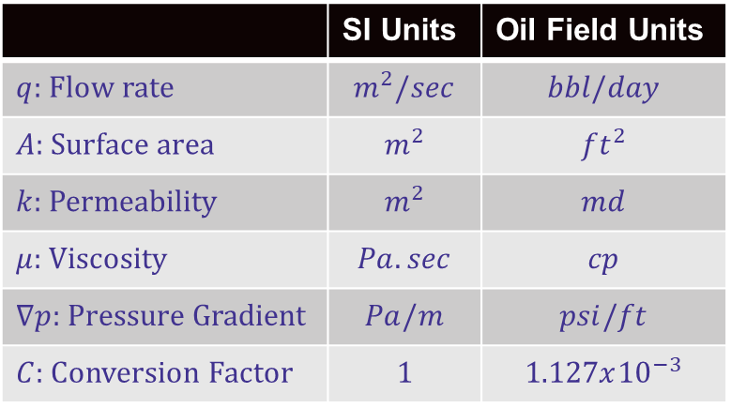
Question: If you have 3 ft long core with 1 md permeability and you apply 14.7 psi pressure difference to the two ends, and the flowing fluid is water (μ = 1 cP) and the core has a cross-sectional area 1 ft², what would be the flow rate (bbl/day)?
Darcy’s Equation $q=−C\frac{kA}{μ}∇p$
Responses by out of the box LLM (as of March 2025)
Trial | Ground Truth | Response | Error % | User Feedback to LLM
1 | 0.00552 | 4.9 | 88668.12 | -
2 | 0.00552 | 0.004900 | 11.23 | Instructed to use field units
3 | 0.00552 | 0.004965 | 10.05 | Asked to use Darcy equation for field units which has the conversion factor of 1.127 * 10⁽⁻³⁾
4 | 0.00552 | 0.00552 | 0.00 | Told the LLM that the correct answer needs to be 0.00552!
 | SI Units | Oil Field Units
$q:$ Flow rate | $$m^{2}/sec$$ | $$bbl/day$$
$A:$ Surface area | $$m^{2}$$ | $$ft^{2}$$
$k$: Permeability | $$m^{2}$$ | $$md$$
$μ$: Viscosity | $$Pa.sec$$ | $$cp$$
$∇p:$ Pressure Gradient | $$Pa/m$$ | $$psi/ft$$
$C:$ Conversion Factor | $$1$$ | $$1.127x{10}^{−3}$$

Slide 11
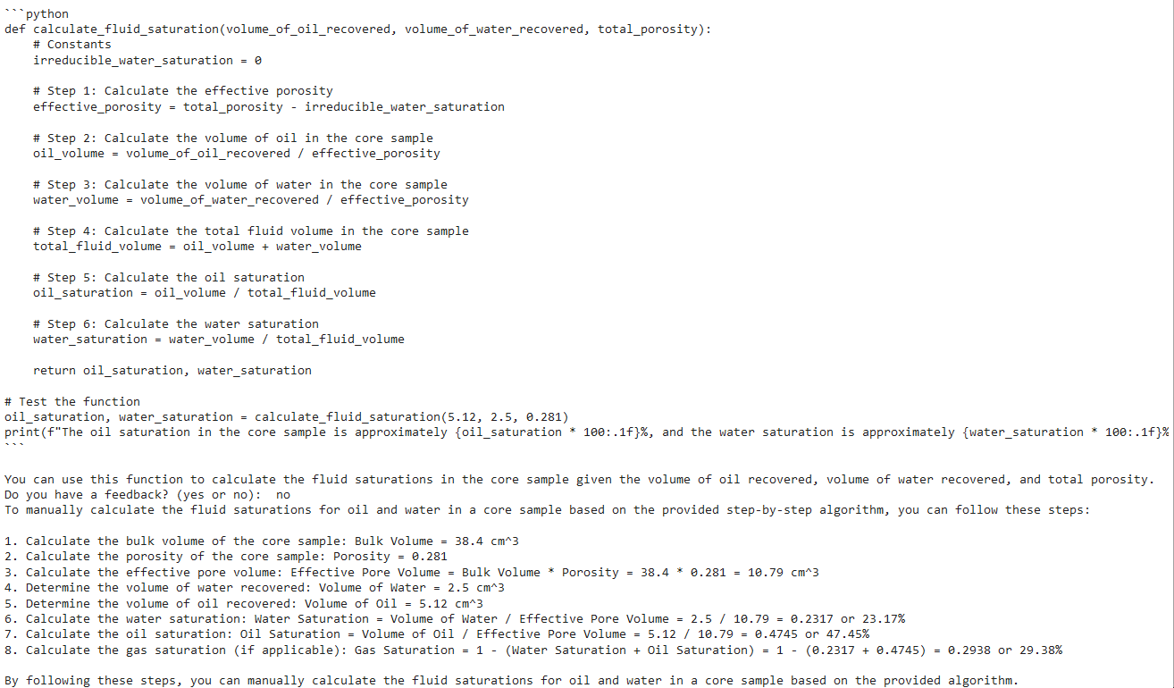
Numerical Question
Query | Query Classification | Response
During a fluid saturations determination study, oil and water volumes were extracted from a core sample with bulk volume of 38.4 cm3, and porosity of 0.281. After applying necessary corrections, 5.12 cm3 of oil and 2.5 cm3 of water were recovered. Determine the fluid saturations. | Numerical
Numerical question posed by user
Generated code using concept template with step-by-step explanation
Notes:
For numerical or code-based problems, the system takes a more structured approach to ensure correctness and precision. Once the query is classified as a numerical or a code-related problem, it is routed to the Concept Agent (CA). The CA performs reasoning and generates a step-by-step procedure to solve the problem. For

Slide 12
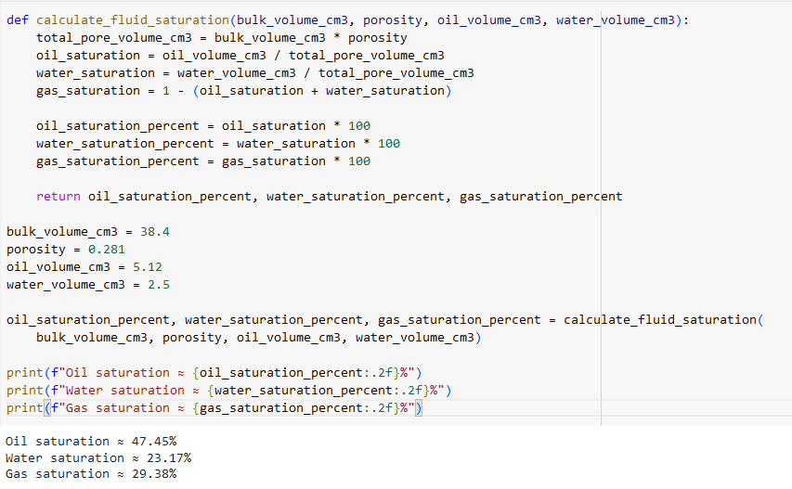
LLM-Generated Revised & Final Python Code
oil_saturation_percent, water_saturation_percent, gas_saturation_percent = calculate_fluid_saturation(bulk_volume_cm3, porosity, oil_volume_cm3, water_volume_cm3)
An example of execution agent in sand-box environment.
feedback = “the correct answers are {'Oil saturation': 47.4, 'Water saturation': 23.2, ''Remaining pore space (Gas saturation)': 29.4}”
An example of feedback with correct answer is provided as an input.
Corrected code snippet after feedback.
Notes:
The input of the Execution Agent (EA) is the code generated by preceding agent. This agent then calculates the numerical output

Slide 13
Manual Step-by-Step Explanation for Students (generated by the TA Chatbot)
To manually calculate the fluid saturations for oil and water in a core sample based on the provided step-by-step algorithm, you can follow these steps:
1. Calculate the bulk volume of the core sample: Bulk Volume = 38.4 cm^3
2. Calculate the porosity of the core sample: Porosity = 0.281
3. Calculate the effective pore volume: Effective Pore Volume = Bulk Volume * Porosity = 38.4 * 0.281 = 10.79 cm^3
4. Determine the volume of water recovered: Volume of Water = 2.5 cm^3
5. Determine the volume of oil recovered: Volume of Oil = 5.12 cm^3
6. Calculate the water saturation: Water Saturation = Volume of Water / Effective Pore Volume = 2.5 / 10.79 = 0.2317 or 23.17%
7. Calculate the oil saturation: Oil Saturation = Volume of Oil / Effective Pore Volume = 5.12 / 10.79 = 0.4745 or 47.45%
8. Calculate the gas saturation (if applicable): Gas Saturation = 1 - (Water Saturation + Oil Saturation) = 1 - (0.2317 + 0.4745) = 0.2938 or 29.38%
By following these steps, you can manually calculate the fluid saturations for oil and water in a core sample based on the provided algorithm.
An example of step-by-step explanation of manual calculation of the fluid saturations for oil and water in a core sample.
Notes:
Our TA chatbot, however, was trained to pay close attention to the units, by converting everything to a consistent unit system before performing any calculations and converting the results back to the desired unit system once calculations are completed, thus providing the correct answer, which was equal to the ground truth, in the first trial for the same prompt that was provided to other models.

Slide 14
Complete Solution for Students (Generated by TA Chatbot)
To determine the fluid saturations, we first need to calculate the bulk volume occupied by oil and water and then calculate the fluid saturations. Here is the step-by-step algorithm to solve the problem:
1. Calculate the total bulk volume of fluids recovered:
Total recovered volume = Volume of oil + Volume of water Total recovered volume = 5.12 cm³ + 2.5 cm³
Total recovered volume = 7.62 cm³
2. Calculate the effective pore volume:
Effective pore volume = Bulk volume of the core sample x porosity
Effective pore volume = 38.4 cm³ x 0.281 Effective pore volume = 10.78 cm³
3. Calculate the fluid saturations:
Oil saturation = (Volume of oil / Effective pore volume) x 100% Oil saturation = (5.12 cm³ / 10.78 cm³) x 100%
Oil saturation = 0.475 x 100%
Oil saturation = 47.5%
Water saturation = (Volume of water / Effective pore volume) x 100%
Water saturation = (2.5 cm³ / 10.78 cm³) x 100%
Water saturation = 0.232 x 100%
Water saturation = 23.2%
4. Verify the calculations:
Oil saturation + Water saturation = 47.5% + 23.2% = 70.7%
As oil and water are the only two fluids present, the total fluid saturation should add up to 100%.
Therefore, the fluid saturations are: -
Oil saturation: 47.5%
Water saturation: 23.2%
Remaining pore space occupied by gas (Gas saturation): 29.3% (100% - 47.5% - 23.2%)
Concept template for numerical question illustrated in previous slide.
Notes:
The input to the code generator is the concept template. It takes the concept template and generates a python code with basic python construct that can be executed without including complex dependencies. For example, in numerical problems, it applies relevant formulas provided in a concept template step by step.

Slide 15
Programming / Coding Path: RAG Workflow
Query | Query Classification | Response
Write code for nth number of Fibonacci sequence code | Code | Sure! Here is a step-by-step algorithm to find the nth number of the Fibonacci sequence: 1. Define a function that takes an input `n` which represents the position of the Fibonacci number in the sequence. 2. Initialize two variables, `a` and `b`, to 0 and 1 respectively. These will represent the first two numbers in the sequence. 3. If `n` is 0, return 0. If `n` is 1, return 1. These are the base cases for the Fibonacci sequence. 4. Loop `n-1` times (since we have already considered the first two numbers in the sequence). a. Compute the next Fibonacci number by adding `a` and `b`. b. Update `a` and `b` to be the last two Fibonacci numbers calculated. 5. After the loop finishes, return the value of `b`, which is the nth Fibonacci number.
Table: Response generation to programming related questions.

Slide 16
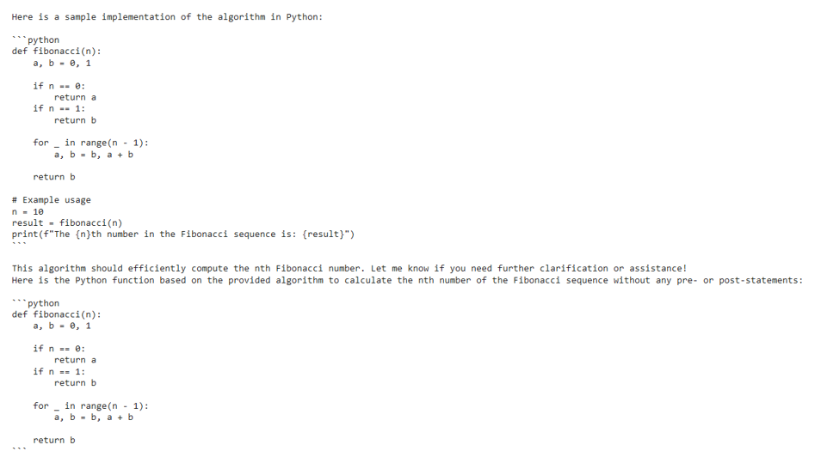
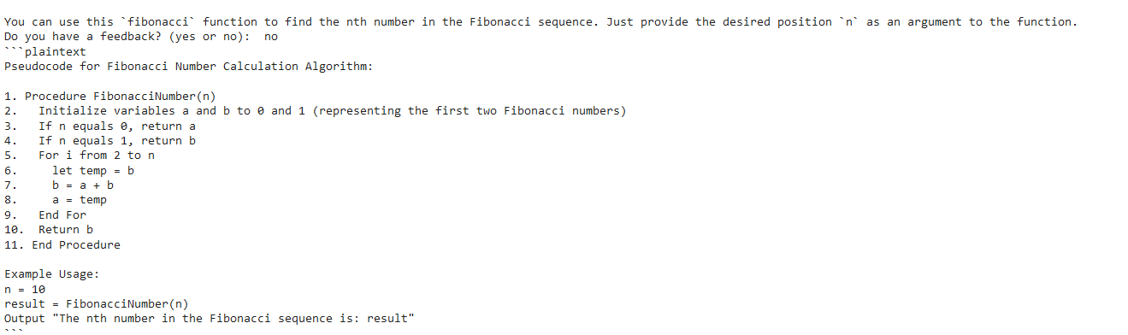
LLM-Generated Initial Python Code
Sample pseudo-output for a given Fibonacci problem.
Response generation to compute n^{th} Fibonacci number.

Slide 17
Acknowledgements / Future Directions
Thank you to:
Predictive Analytics and Technology Integration Laboratory (MSU)
Marchant Endowed Chair (MSU)
Office of the Senior Vice President & Provost (ISU)
Department of Computer Science (UA)
What’s next?
Product Testing / User Studies
Version(s) 3.0 to support academic student success
Notes:
expand our chatbot’s capabilities to additional high DFW courses, such as engineering mechanics/statics (with problems such as bridge / truss analysis), as well as other computer science courses, (including data structures and algorithm optimization techniques, as well as cybersecurity and digital forensics).

Slide 18
Thanks for Listening with great patience
Any Questions?

