Slide 1
Computing in Chemical Engineering Survey
Robert Hesketh and Martha Grover
Wednesday November 13, 2019

Slide 2
Survey and Summary of Responses
This survey is in two parts:
Industry: 307 responses from ChE’s in the chemical industry
University: 154 responses from 70 chemical engineering departments
Previous surveys in 1997 and 2003 did not survey faculty or students at universities.

Slide 3
Computing in Chemical Engineering: Universities
Questions asked:
How is computing taught in the curriculum?
Is it effective?
What are the needs?

Slide 4
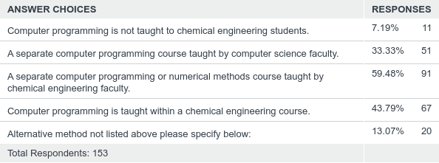
How is computing taught in the curriculum?
Is computer programming taught to your chemical engineering students?
Programming is taught by chemical engineering faculty.

Slide 5
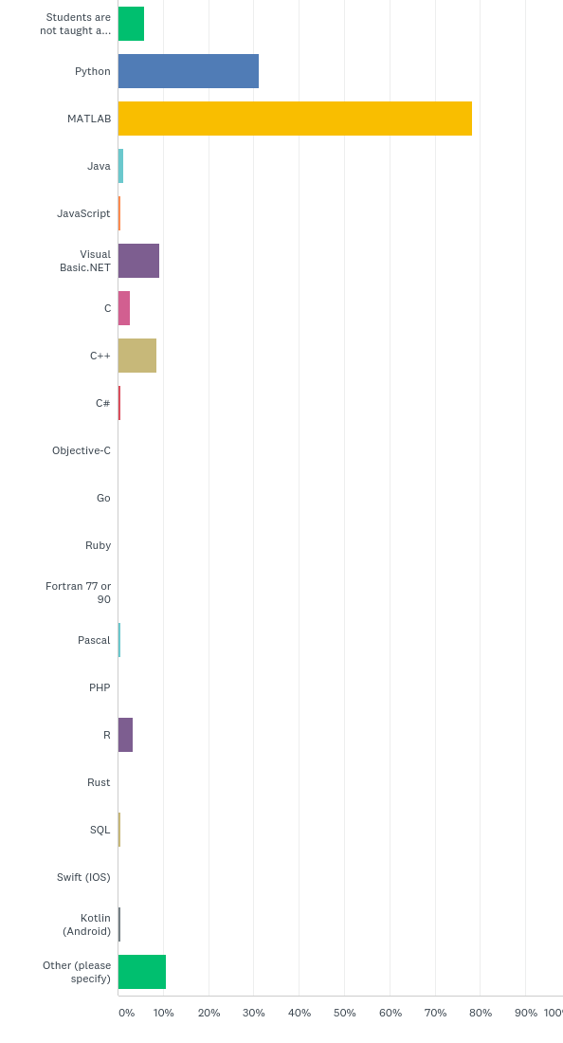
How is computing taught in the curriculum?
What language is taught?
Python is new since previous surveys, MATLAB is not.

Slide 6
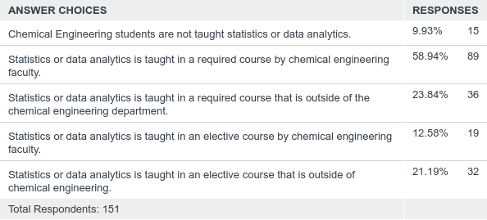
How is computing taught in the curriculum?
What courses cover statistics or data analytics?
Statistics or data analytics is required.

Slide 7
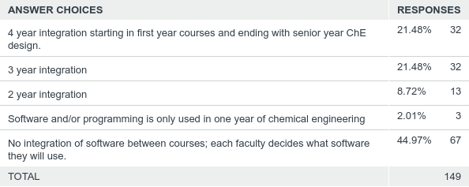
How is computing taught in the curriculum?
Is there integration of software between courses?
Students are learning multiple software packages.

Slide 8
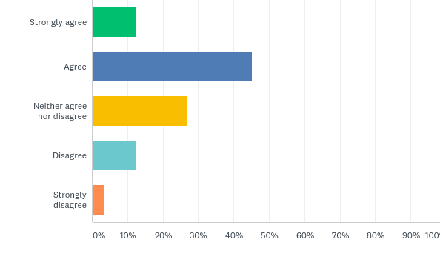
How well are our students prepared?
Do you agree with the statement, “Graduates are well prepared to use computer software and programming to solve engineering problems?”
Just over half of faculty believe
that students are well prepared.

Slide 9
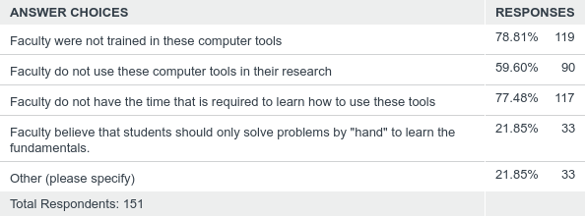
What are the needs?
What are the barriers that faculty have for not using computer aids effectively in your undergraduate curriculum?

Slide 10
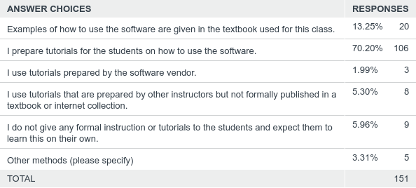
What are the needs?
What method do you use to introduce students to the computational software that you use in your classes?

Slide 11
307
Computing in Chemical Engineering Survey: Industry
Total Responses
Date Created: Monday, November 12, 2018
Complete Responses: 307
Notes:
2003 Survey had 293 responses

Slide 12
No respondents had an MS degree!

Slide 13
Computing in Industry comparison with previous years
Year | 2019 | 2003 | 1997
R & D | 25% (75) | 25% (69) | 18%
Plant/Process Support | 18% (55) | 22% (60) | 21%
Process Design/Analysis | 29% (88) | 18% (48) | 20%
Process Control | 3% (10) | 8% (21) | 16%
Administrative | 11% (33) | 5% (13) | 13%
Systems |  | 2% (6) | 8%
Other | 15% (45) | 21% (58)

Slide 14
Q3: Professional Experience
Answered: 306 Skipped: 1
PhD had 35% over 21 years
BS had 45% under 5 years
Notes:
Make one chart

Slide 15
Q4: Which of the following is most appropriate for your industry? Please rank these from 1 being the most important and 4 least important. Chose N/A if the choice is not applicable for your industry.
Answered: 304 Skipped: 3

Slide 16
Q4: Which of the following is most appropriate for your industry? Please rank these from 1 being the most important and 4 least important. Chose N/A if the choice is not applicable for your industry.
Answered: 304 Skipped: 3

Slide 17
Q4: Which of the following is most appropriate for your industry? Please rank these from 1 being the most important and 4 least important. Chose N/A if the choice is not applicable for your industry.

Slide 18
Please rank the primary tasks that require the use of spreadsheet software. (1 high usage and 5 is low usage) If Excel is not used for these type of calculations check the "not used box". 2019 is the addition of those that chose 1 and 2 out of 5
 | 2019 |  | 2003
Process data analysis (collection and statistical analysis) | 70% | (213) | 88.2% (253)
Economic studies (inventory/accounting) | 38% | (114) | 23.7% (68)
Engineering design calculations | 36% | (108)
Material and energy balance calculations (process analysis) | 28% | (85) | 25.1% (72)
Numerical analysis (multiple algebraic-equation systems, integration, differential equations, etc.) | 13% | (38) | 47.4% (136)
From 2003 survey: Other (e.g., reporting, financial modeling, emissions calculations, etc.) |  |  | 16.7% (48)
Notes:
The only change is that performing numerical analysis using excel has dropped.

Slide 19
Notes:
Statistical software has increased from 2003:2019 (27% to 60%), Numerical Analysis has increased 2003:2019 (25.5% compared to 38.3%) The following has remained fairly constant: Database (66% compared to 61%) Symbolic (10% vs 15%) IMSL (6.3 % vs 6.5%)

Slide 20
Use of Process Simulators Comparison between 2003 and 2019
Notes:
Use of process simulators has not changed

Slide 21
Q9: How strongly do you agree with this statement, "I was adequately educated at my university to use and understand chemical process simulation programs."
Answered: 305 Skipped: 2
 | 2019 | 2003
Yes | 56% | 49%
No | 17% | 22%
No Opinion | 12% | 29%
Universities preparation for use of chemical process simulators hasn’t changed

Slide 22
Q11: When training is required for a software program, rate the training method that you used.
Answered: 299 Skipped: 8
How do you learn new software? Mostly Self Taught and Colleagues
 | 2019* | 2003 | 1997
Self-taught | 83% | 71% | 58%
Colleagues | 58% | 14% | 16%
Company provided training program | 25% | 9% | 16%
Others (Training Companies, Tool Vendor, School, etc.) | 28% | 6% | 10%
2019* Combined Primary source & used many times

Slide 23
Q14: Do you write computer programs at work to solve engineering problems? If so what language do you use?
Answered: 303 Skipped: 4
Shift to Python and MATLAB for programming languages
Notes:
combine

Slide 24
Q15: How strongly do you agree with this statement? "Your new chemical engineering hires have sufficient education in statistics and data analytics."
Answered: 303 Skipped: 4
Strong difference between PhD and BS opinion
Notes:
Combine comment on the current required course keep this course

Slide 25
Conclusions
Chemical Engineers predominately use computer programs in their work.
Computer programming in industry is not a major task done by ChE’s.
Excel is a major tool used by ChE’s in industry.
The use of Statistical and Numerical Analysis software has increased in use by ChE’s in industry.
The use of MATLAB and Python has increased from 2003.
Machine Learning and Statistics and Data Analytics is an area that is expected to grow in the future. We need to evaluate the effectiveness of our teaching of this subject.
The effective use of Python and data analytics are emerging opportunities in education.
Software tutorials are needed that faculty, students, and industry could use.

