Slide 1

Sampling of Data Education in ChE Curricula*
Richard D. Braatz, MIT
* Presented at the 2022 ASEE/AIChE Chemical Engineering Summer School
Photo courtesy of Indeed Hiring Lab

Slide 2
Purpose and Goals of This Presentation
The purpose is to provide materials and best practices to help new faculty in teaching applied statistics and data analytics
The goals are to
  learn about various subtopics within applied statistics and data analytics to assist in deciding what to include within the time allotted to this area within their curriculum
  become familiar with available teaching materials and software resources
  learn some best practices for imparting useful skills to undergraduate students
  learn how the topics and skills connect with (and support) other topics in
  the chemical engineering curriculum

Slide 3
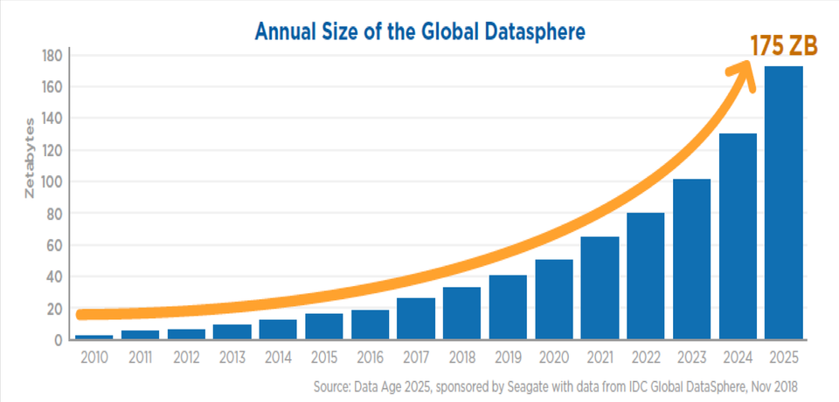
Why ChEs needs to learn process data analytics
Companies are using data to streamline operations, improve reliability, optimize processes
Driven by huge increases in data and reduced computer costs
Driving demand for scientists and engineers with expertise in analytics
175 ZB
180
160
140
120
100
80
60
40
20
0
Industry considers it essential that ChEs are taught applied statistics (Chemical Engineering Academia-Industry Alignment: Expectations about New Graduates, AIChE, New York, 2015)
Global Datasphere (1 Zetabyte = 10²¹ bytes)
Zetabytes
2010 2011 2012 2013 2014 2015 2016 2017 2018 2019 2020 2021 2022 2023 2024 2025
Figure adapted from Seagate
Notes:
10²¹bytes = 1 ZB = 1 trillion GBs, https://data-flair.training/blogs/job-in-data-science-career/
Figure courtesy of Opera Solutions, https://www.tecla.io/blog/the-high-demand-for-data-scientists-and-how-to-hire-for-them/
insert slides on opportunities, incorporate plant-wide slides as opportunities. consider adding analysis from Retsef Group
From January 2015 to January 2018, job postings for data scientists rose by 75%.
P&ID and Growth in Postings from Indeed Hiring Lab
This talk will summarize the status of data education in chemical engineering curricula, providing examples where data are not covered at all to some examples of the efforts of dedicated faculty to including data in the curricula. It will discuss why existing engineering curricula have little coverage of data and why this situation is difficult to change. The last part of the talk will describe efforts at MIT to train chemical engineering students to analyze and make decisions based on heterogeneous data sets ranging in size from small to very big. The talk will describe ideas to integrate OSIsoft into other chemical engineering curricula, including (1) development of insertion modules with clearly defined learning objectives and with varying time commitments, (2) making tutorial visualizations and remote software operation available to universities, and (3) supporting “data advocates” within specific programs to develop and evaluate insertion modules.

Slide 4



Data Analytics at All Levels in the Chemical Industry
ECOSYSTEM DATA
Utilize ecosystem data to connect customer needs to manufacturing data
PLANT / FACTORY / FAB
Utilize plant-wide data (numerical, textual) to optimize operational models
PROCESSES
Automated data archiving stores data for process modelling and analysis, for improved monitoring and control
Consistent production of quality product
Upstream
Downstream
Packaging
Use all available data to ensure product quality specifications are met
Objectives: Diagnostics/Prognostics, Continuous Improvement, and Optimal Decision Making

Slide 5
Examples of Typical Data Analytics Applications
Many companies have built the infrastructure to bring the data into one database for easy access
Correlate plant data to off-line product quality specs
Connect product quality data to the supply chain
Troubleshoot problems in plant operation such as causes of off-spec product (e.g., raw materials, operator error)
Propose process or control design changes to reduce operational problems
Optimize operations, e.g., selection of raw materials or mixtures from multiple suppliers
Design predictive maintenance schedules
Facilitate continuous improvement practices
Plant-level operational data
Optimize inspection resource allocation
Root cause analysis for low quality output
Early, automated quality detection
Optimize production scheduling
Predict machinery maintenance needs

Slide 6
Spectrum of Data Education in ChE Curricula
a few lectures in a process design course
a course in statistics taught from the mathematics department
a course in applied statistics taught by a chemical engineering department
a course in experimental design from an industrial engineering department
an applied statistics four-week module taught as part of an applied mathematics course
an introduction to applied statistics and data analytics four-week module taught as part of a process systems engineering course

Slide 7
Sample Topics in Statistics/Data Analytics Courses in ChE
Experimental design: generate data so that the model will be good enough
Linear/nonlinear regression: least-squares, response surface methodology
Uncertainty quantification: estimation of confidence & prediction intervals
Chemometrics: handling correlated data (e.g., PLS, PCA, FDA)
Statistical process control: do data indicate that the process is under control? which variables are likely associated with the fault? how to classify new data based on historical data?
Machine learning: sparse vs. dense models, construction of sparse models, lasso & elastic net, neural networks

Slide 8
Example: Data Education at the University of Buffalo
14 weeks to juniors
Lecturer: David A. Kofke (ChE)
William Navidi, Statistics for Engineers & Scientists
Sampling and descriptive statistics, probability, error propagation, common distributions, confidence intervals, hypothesis testing, factorial experiments

Slide 9
Example: Data Education at UT Austin
16 weeks to juniors
Lecturer: Keith Friedman (ChE)
R.A. Johnson, Statistics & Probability for Engineers
Linear regression, JMP, simple distributions, confidence intervals, ANOVA, hypothesis testing, design of experiments, statistical process control

Slide 10
Example: Data Education at Brigham Young University
14 weeks to sophomores, 14 weeks elective for seniors & graduate students
Lecturers: Matt Heiner (Stats), Larry Baxter (ChE), John Hedengren (ChE)
William Navidi, Statistics for Engineers & Scientists, Lecture Notes and Online for Seniors/Grad Students
The scientific method; probability, random variables, common discrete and continuous random variables, central limit theorem; confidence intervals and hypothesis testing; completely randomized experiments; factorial experiments

Slide 11

Example: Data Education at MIT (Elective)
Course objectives:
Learn data analytics methods & selection of methods for specific applications
Gain experience in applying analytics methods to real, authentic datasets
Provide enough understanding to be able to troubleshoot unexpected results
Plant-level operational data
Optimize inspection resource allocation
Root cause analysis for low quality output
Early, automated quality detection
Optimize production scheduling
Predict machinery maintenance needs
Topics include
unsupervised, supervised, and semi-supervised learning
correlation analysis, latent variable methods
temporal data and time series analysis
feature engineering, kernel methods
neural networks
ensemble learning, random forest
real-time video, hyperspectral imaging
Course data
Matlab-based problem sets and projects
All electronic course materials
Acquisition, use, and storage of contextualized data
Learn from the Data – Information and Knowledge
Analytics, modelling, simulation

Slide 12
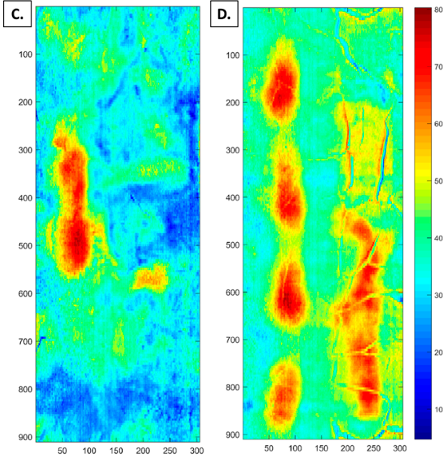
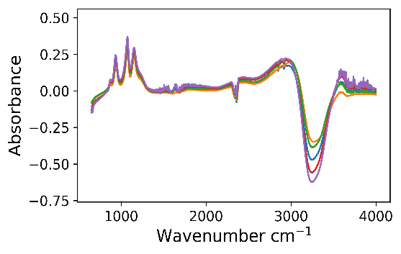
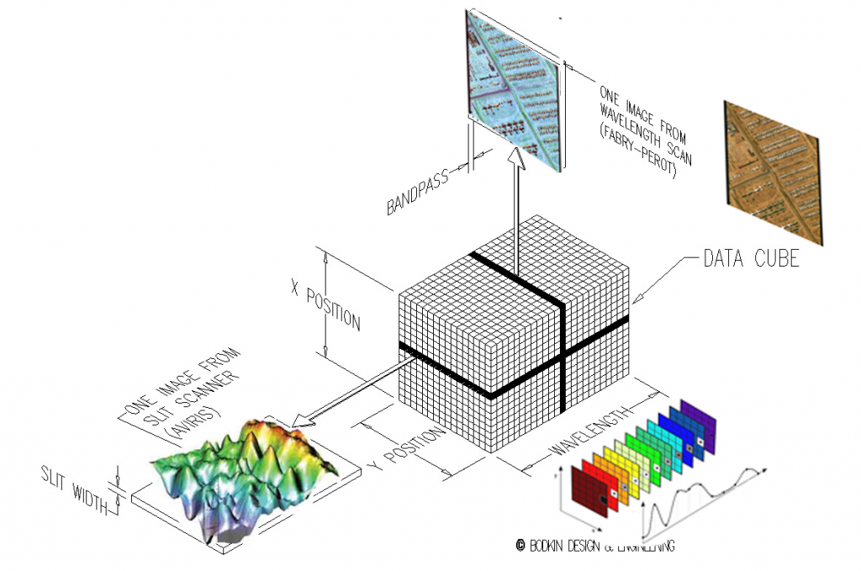
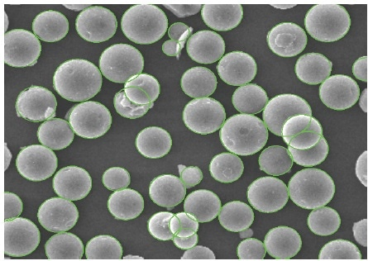
Course covers a wide variety of process datasets
Hyperspectral Imaging
Spectra
Optical Imaging and Video
Notes:
Image from: https://www.azonano.com/article.aspx?ArticleID=4457
http://www.bodkindesign.com/products-page/hyperspectral-imaging/
replace PSD with cell size or other distribution, include time series of a dataset type, use images from bioprocessing

Slide 13
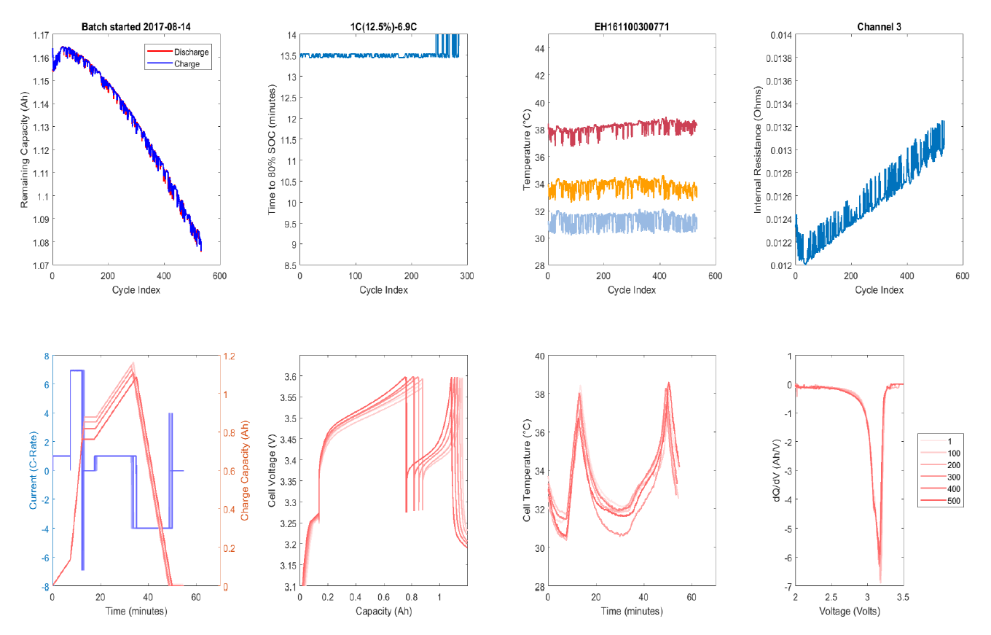
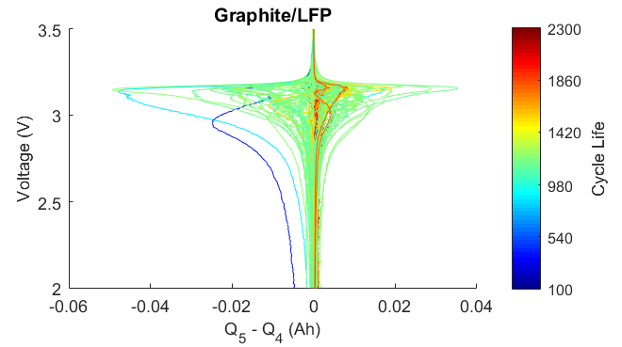
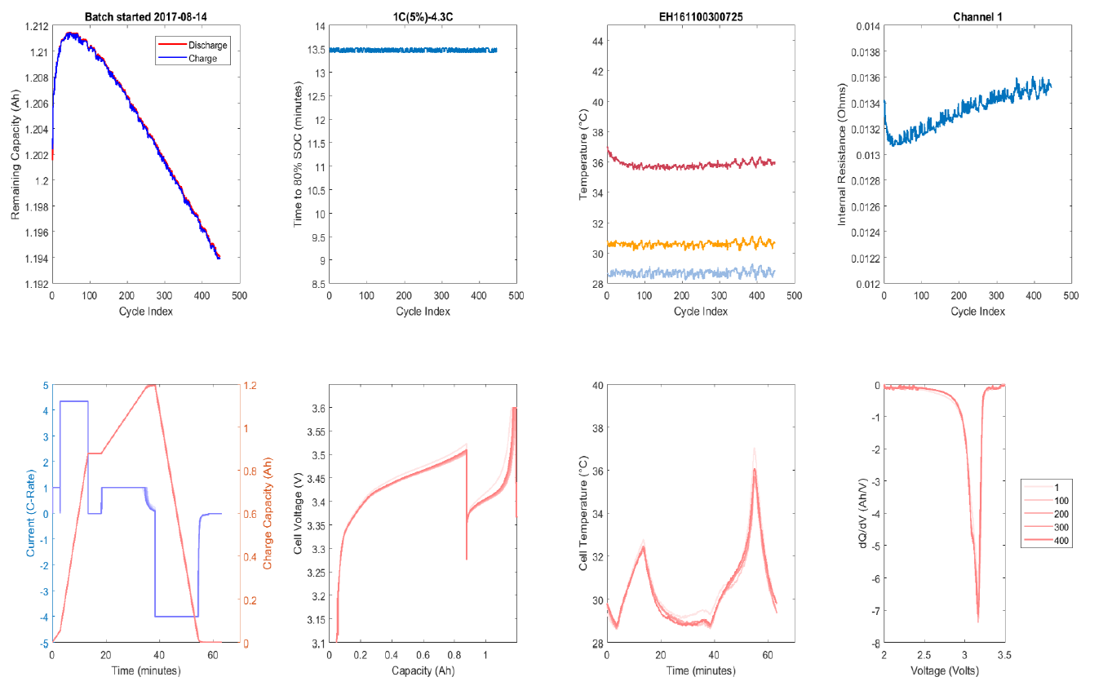
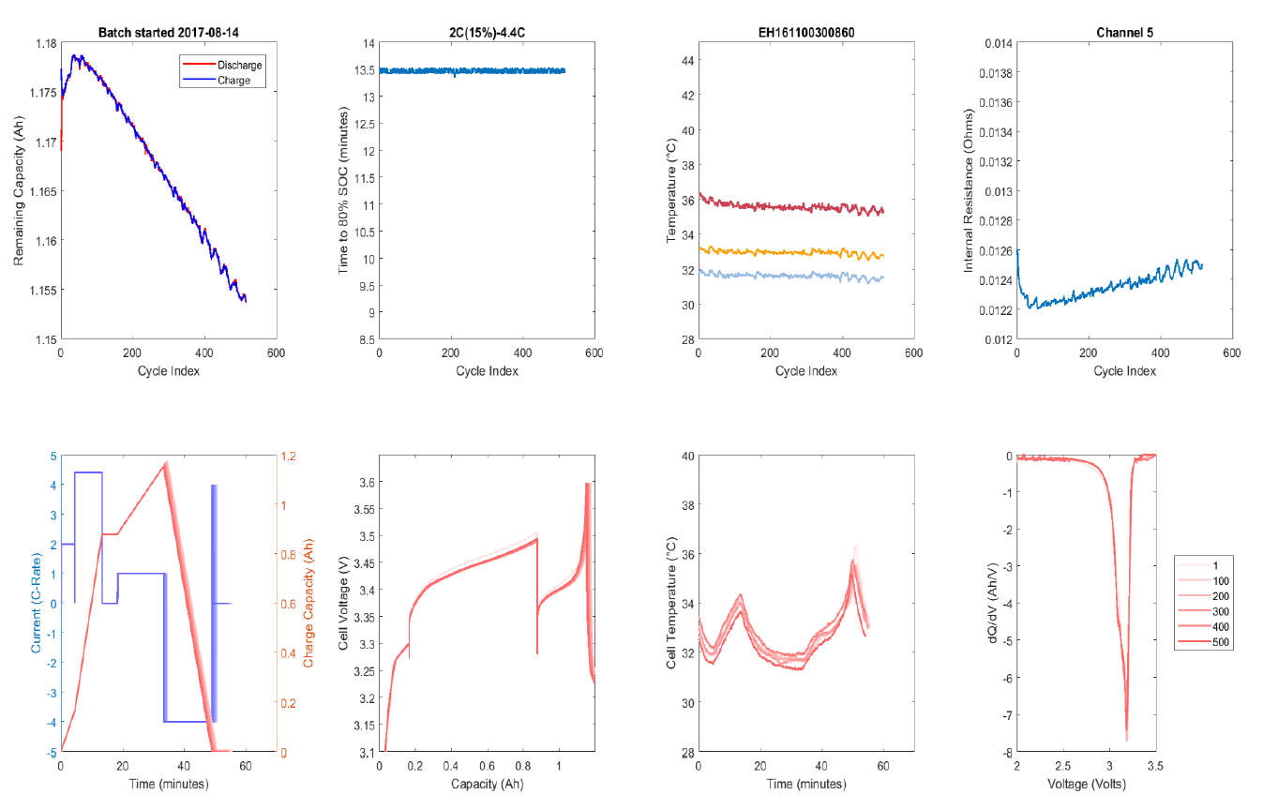
Course only uses authentic data
Predict battery cycle life from data collected during the first 110 cycles
Classify batteries into long and short lifetime based on data collected during only the first 5 cycles, before capacity degradation has occurred
Experimental Cycling Data
Feature Engineering & Elastic Net
Classification Modeling
Severson et al., Data-driven prediction of battery cycle life before capacity degradation, Nature Energy, 4, 383-391, 2019

Slide 14
MIT Curriculum: A ChE Specialization in Process Data Analytics
10 ENG options
Biomedical
Energy
Engineering Computation
Environmental
Manufacturing Design
Materials Processing
Process Data Analytics
Society, Engineering, & Ethics

Slide 15
Course Decision to Make: Which Software to Use?
Matlab: many ChE departments teach Matlab to all of their students (saves time);
many online tutorials are available, http://www.mathworks.com/academia/student_center/tutorials/launchpad.html
Python: open-source and listed in many ChE job opening descriptions
Commercial statistics software, e.g., Minitab: allows graduates to be immediately productive in industry
The best choice for your course depends on the content of previous courses in
the ChE curriculum and the expertise of the teaching assistants

Slide 16
Challenges and Synergies
Some ChE curricula do not include linear algebra → forces the course to include linear algebra or shy away from some methods, e.g., PCA/PLS
Some ChE curricula do not include optimization → relatively easy to include basic concepts the course
Some ChE curricula do not include computer programming → can manage by focusing on problem-solving with software, e.g., SAS JMP, minitab
Data education integrates well with any earlier courses in linear algebra, optimization, and computer programming

Slide 17
Hands-on exploration of web-based resources
CACHE Teaching Resource on Data, Statistics, and Analytics
Syllabi, textbooks, screencasts, links to other resources
https://cache.org/teaching-resources-center/statistics
LearnChemE Statistics Screencasts
>60 short screencast videos on statistics, including examples, introduction to topics, software tutorials, and exam review problems
https://learncheme.com/screencasts/statistics/
Virtual Laboratories in Probability and Statistics
Interactive web-based resources for students and teachers
http://www.math.uah.edu/stat
Online Statistics and Probability Course
Video lectures, slides, homework, and practice final
http://www.lithoguru.com/scientist/statistics/review.html

